Slide 1

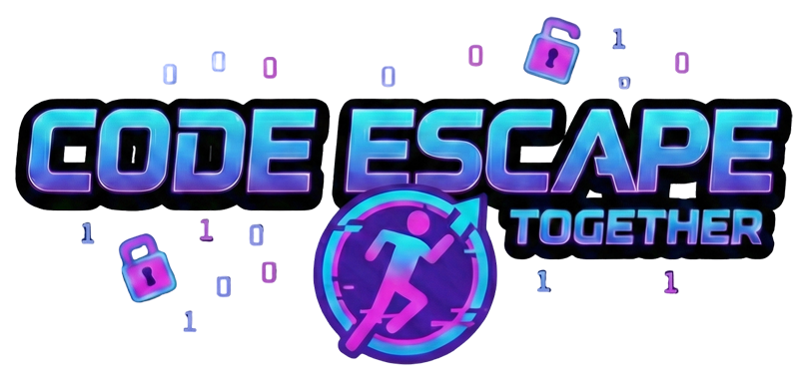
Code escape together
26-1-D-16
Daniel Rozentsvaig
Elias Farah
Advisor: Dr. Sulamy Moshe
Notes:
“Good afternoon everyone. Before we start, let me ask you a question: How many of you learned programming alone, sitting in front of a screen?” (pause for reaction) My name is Elias, this is my partner Daniel, and today we’ll present Code Escape Together — a 3D cooperative escape room game that is designed to help teenagers learn programming and encourage teamplay.

Slide 2

Challenges in Teaching Programming Today
Text heavy
Syntax
Low attention span
Lack of interest
Reliance on AI
Notes:
For many beginners, there is a significant barrier between the learner and the first line of code. Programming concepts are often text-heavy, require strict syntax, and demand high levels of concentration.
In addition, factors such as short attention spans and lack of engagement makes it difficult for teenagers to stay motivated. The increasing reliance on AI tools can also reduce independent thinking, potentially delaying the development of analytical and problem-solving skills.
These challenges highlight the need for a more engaging and accessible approach to learning programming.

Slide 3

Game based learning & Escape Rooms as teaching tool
Uses game mechanics to increase engagement
Promote active learning through problem solving and exploration
Increase motivation and participation.
Points, challenges, collaboration
Notes:
One existing approach to improving engagement in learning is Game-Based Learning (GBL).
GBL integrates educational content into game mechanics in order to increase motivation and engagement. Common elements include points, challenges, rewards, and in some cases collaboration between learners.
Studies and existing systems show that GBL can improve participation and learner motivation, especially among younger audiences.
Another relevant approach is educational escape rooms. These environments promote active learning by requiring learners to solve interconnected problems under time constraints. Research shows that escape rooms can significantly improve learner motivation and participation by making the learning process more immersive and goal-driven.

Slide 4
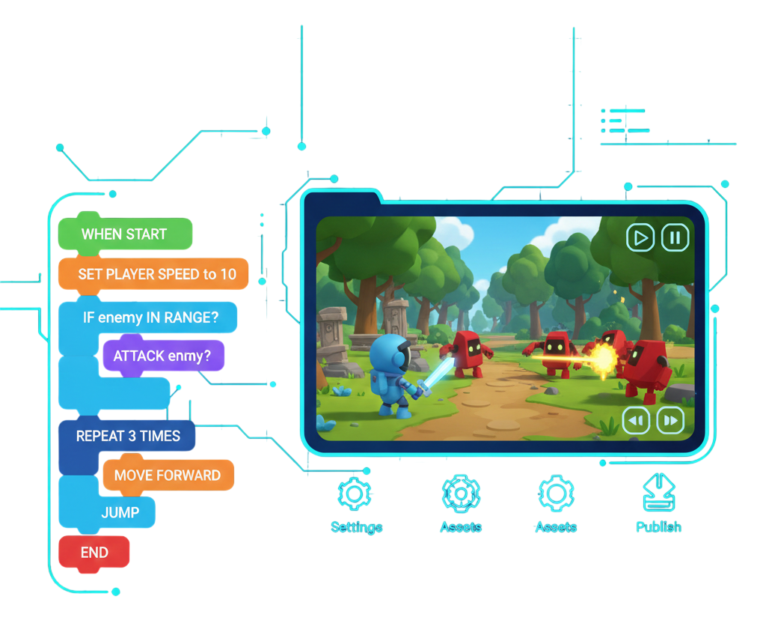
Lowering the Entry Barrier with Visual Programming
Block based, syntax free programming
Emphasizes logic and computational thinking
Notes:
Visual Programming Languages, or VPLs, use blocks instead of text to represent programming constructs. This syntax-free approach allows beginners to focus on logic and computational thinking without worrying about syntax errors, thereby lowering the entry barrier and making the first step into programming easier.

Slide 5
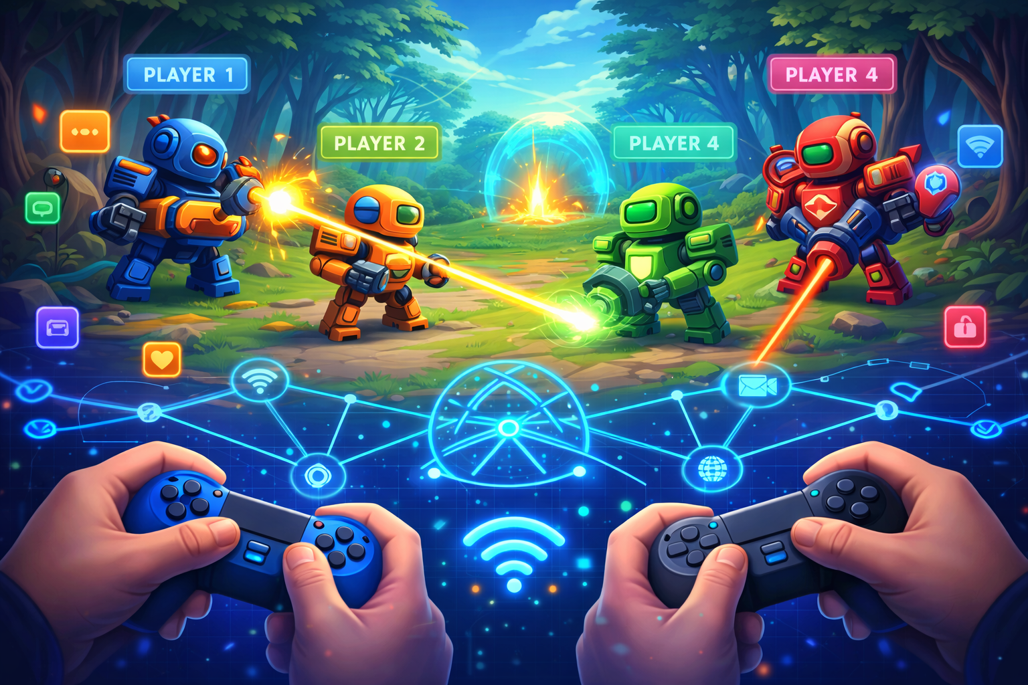
Learning Through Collaboration
Learning through teamwork and communication
Shown to improve understanding and retention
Multiplayer games increase engagement
Often not tightly integrated with programming logic
Notes:
Another important approach is Collaborative or Multiplayer Learning, where learners work together through teamwork and communication. Research shows that this improves both understanding and knowledge retention. Multiplayer serious games can further boost engagement by introducing shared goals and challenges. However, most existing systems are not tightly integrated with programming logic, leaving a gap for projects like ours that combine collaboration with coding tasks.

Slide 6

Challenges That Remain Unsolved
Mostly single-player or large groups
Limited real-time cooperation
No integration of visual programming + escape rooms + co-op
Notes:
While these approaches improve engagement and learning, they have notable limitations. Most systems are single-player or designed for large, loosely organized groups, which reduces effective collaboration. Real-time cooperation is often limited, and importantly, no existing solution combines visual programming, escape room mechanics, and cooperative gameplay in a single learning environment. This gap motivated the design of Code Escape Together.

Slide 7

Our Solution: Code Escape Together
3D Cooperative escape room game for team-based learning
Use smartphone controlled VPL for accessibility
Gradual and logical introduction of programming concepts
Notes:
Our project, Code Escape Together, is designed to address the limitations we just discussed. First, it is a cooperative escape room game, where players must work together to solve programming puzzles. To make the game accessible, it uses a smartphone-controlled visual programming language
And finally programming concepts are introduced in a steady, logical sequence, so learners can gradually build understanding.

Slide 8
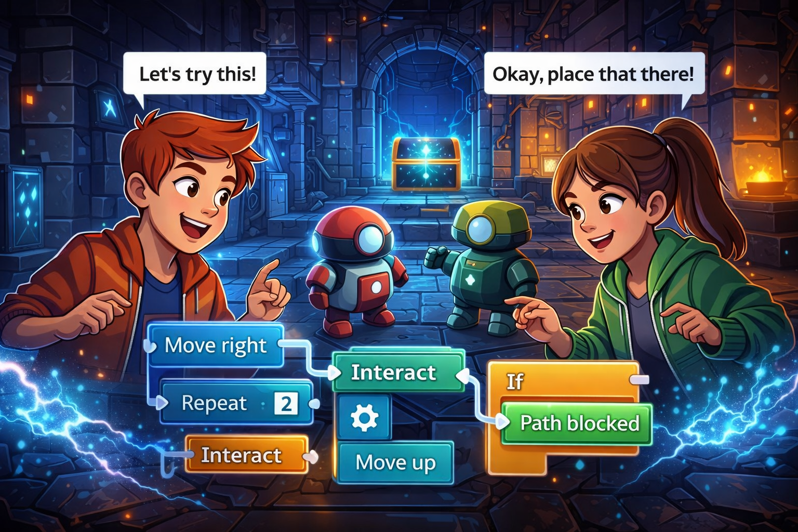
Unique features
2-player co-op
Visual Programming
LAN connection
Notes:
Next, let’s look at the unique features of our project.
First, the game emphasizes cooperative gameplay: players must communicate and think together to solve challenging levels.
Most projects we looked at are focus more than 2 players
Second, we integrate a visual programming language, which allows players to focus on logic and problem-solving instead of syntax.
Most escape room projects we reviewed did not include this.
Finally, the game runs over a local area network, so no internet connection is required - making it accessible in classrooms or restricted networks.
It’s the combination of all three features – cooperative gameplay, visual programming and LAN connection that truly sets our project apart.

Slide 9
Expected Outcomes
Teach basics of programming and computer science to teenagers and beginners
Lower the barrier of programming
Easily set up almost anywhere
Increase engagement and retention
Notes:
So, first the outcomes we expect from the project, our goal is to teach the basics of programming and some computer science to teenagers and beginner programmer.
To lower the barrier of programming we will utilize a smartphone controlled visual programming language as mentioned before; since most people, especially teenagers, have a smartphone.
The game will be easily setup almost anywhere as long as you have a computer, two smartphones and a local network.
And finally, since the game has a cooperative nature to it, we believe it will increase engagement and improve the long-term retention of the material.

Slide 10
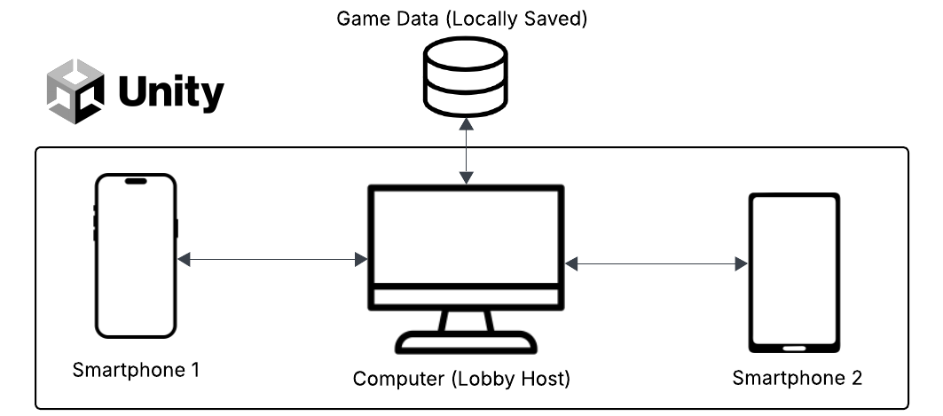
Architecture overview

Slide 11
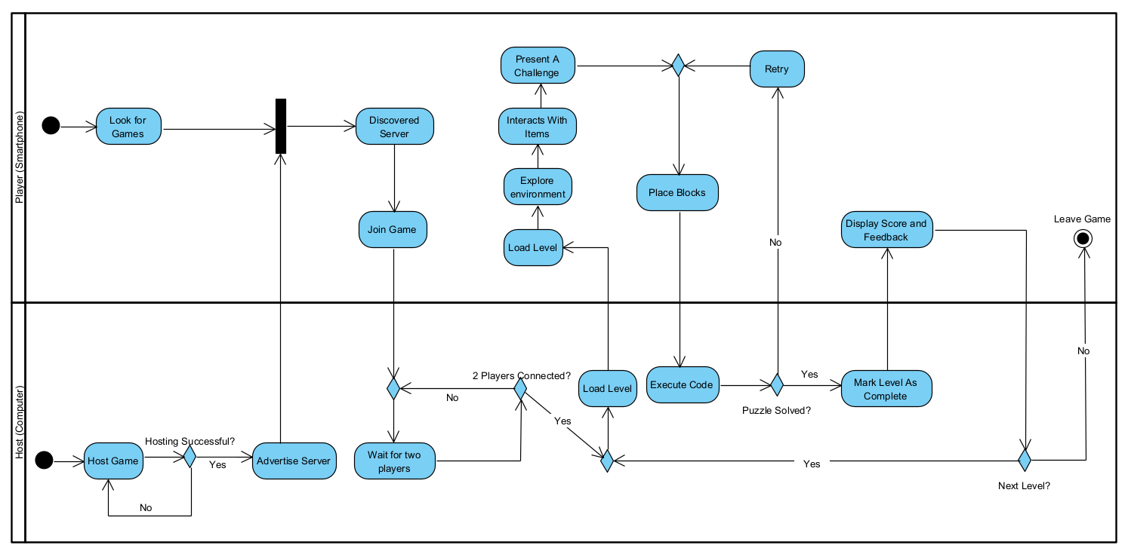
Activity diagram

Slide 12
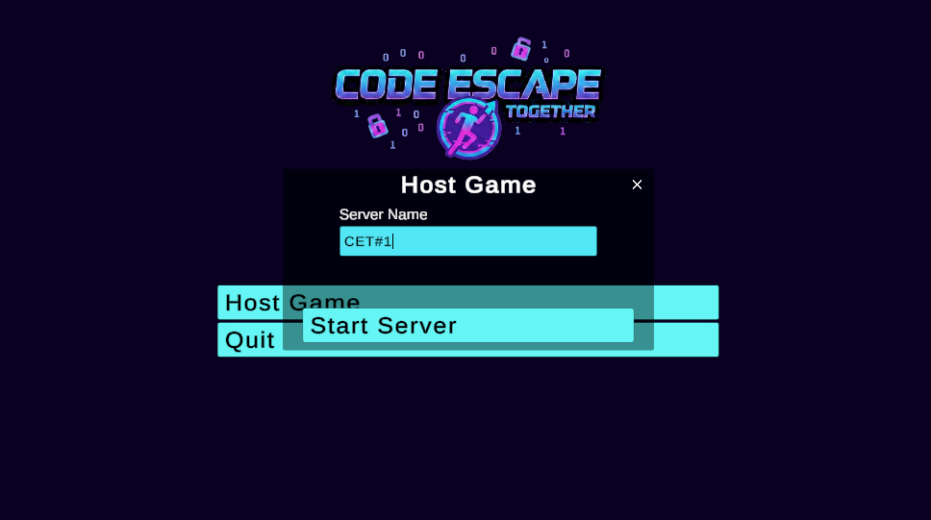
Game Flow: host game

Slide 13
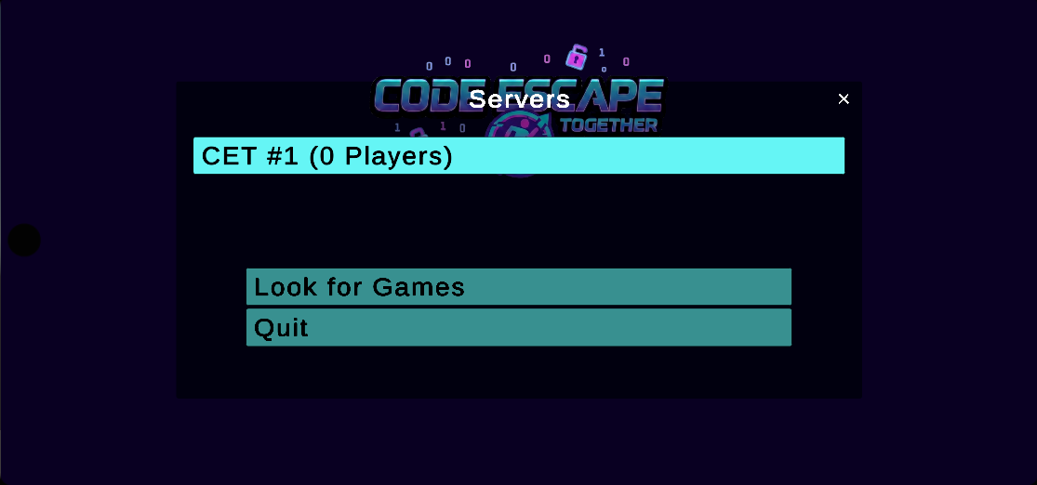
Game Flow: Joining via Smartphone

Slide 14
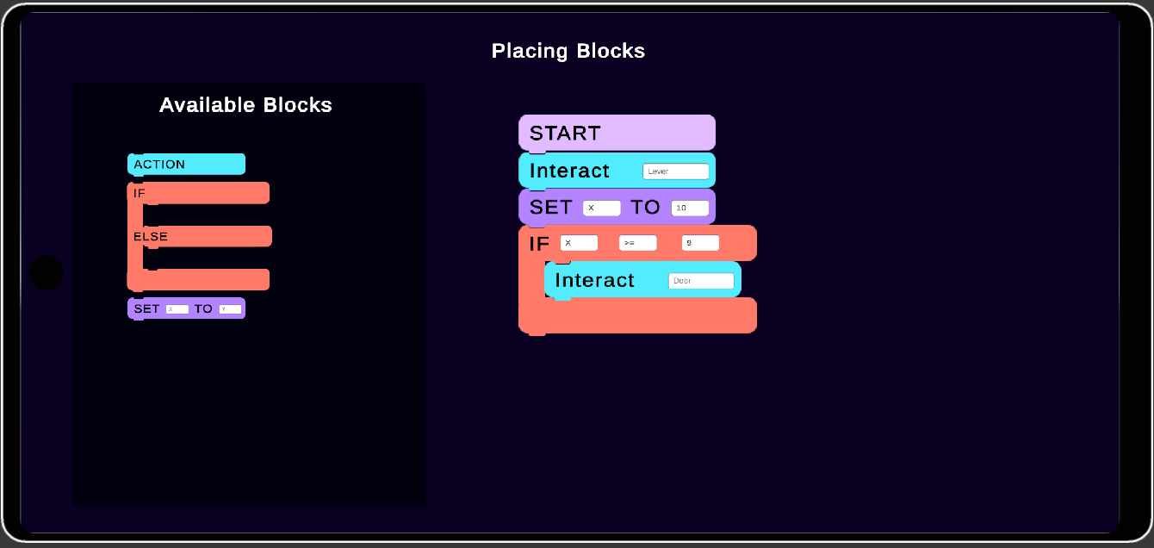
Game Flow: block placement

Slide 15
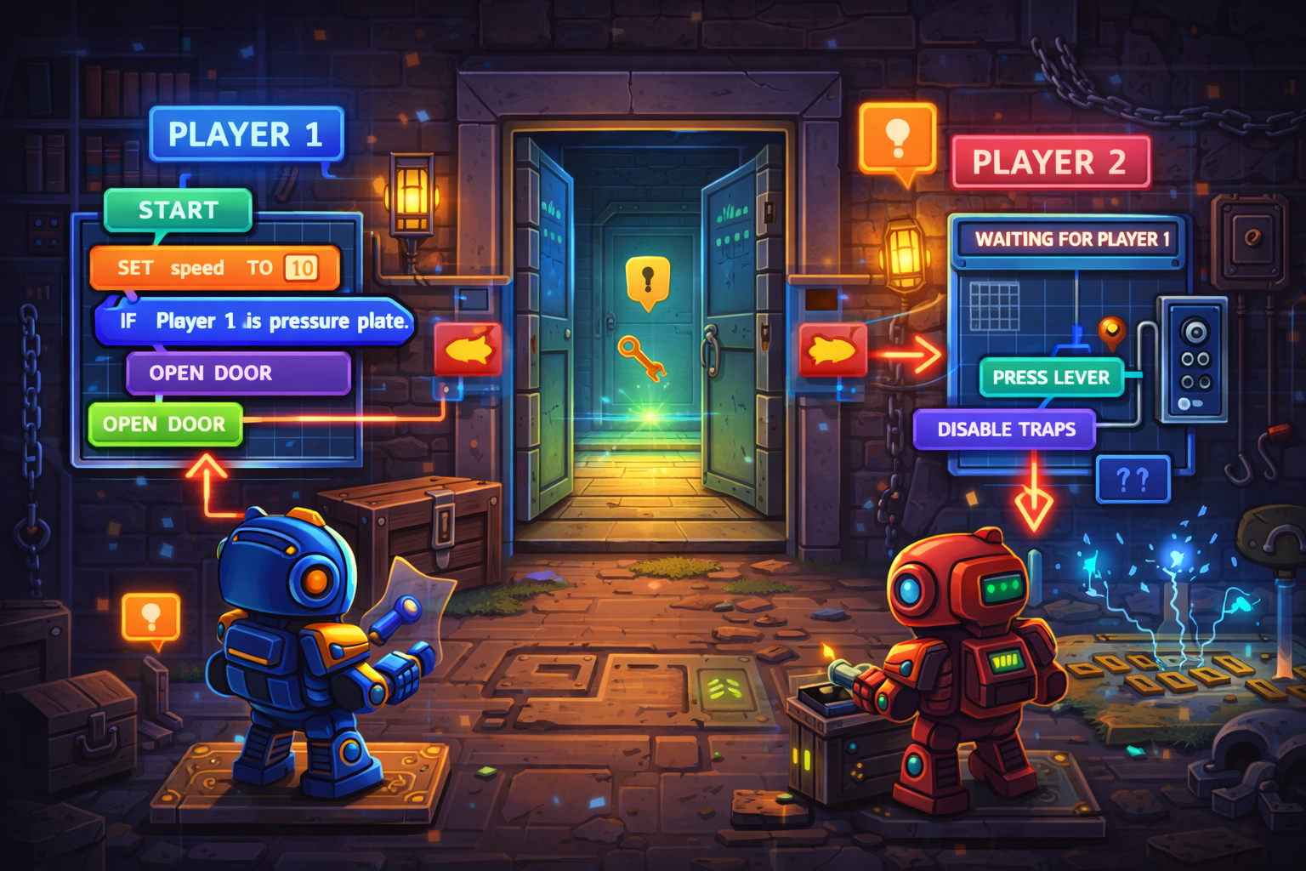
Cooperative gameplay flow
Notes:
Image illustrates HOW CO-OP will be implemented in the game and NOT how the logic works

Slide 16


Research Process
Game development with the Unity Engine
Multiplayer networking with Mirror
Visual Programming Language
Notes:
First, the research phase, before starting to build the game, some work was needed to research and learn the Unity Engine, we’ve chosen Unity since it provides
cross platform support, uses C# which we already know and has plenty of tools to make our vision of the game into a real game.
For communicating between the devices, we’ve chosen a library named Mirror, Mirror support the locally hosted servers with the computer being a server instead of an external server, which has P2P characteristics.
After that, we researched how visual programming languages work to understand how we should design the VPL language that the game will use.
For example, one of the challenges of VPLs, is scalability. As programs grow, the number of blocks can become more difficult to manage and understand.
We looked at existing solutions such as Scratch and Blockly and how they are designed around clear visual patterns.

Slide 17

Development process
Agile methodology
Base project and mirror networking
Designing the menus
VPL system
Making the player system
PoC level and puzzle/escape room system
Scoring & badges system
Notes:
For the development we’ll use the Agile methodology, that is, managing the project in sprints and making iterations until the project is complete.
In each sprint, we’ll discuss the changes and issues together and plan for the future.
Developing the game will focus on the following main steps:
The first step, making a base project in Unity using the Mirror library to see how it works and successfully communicating between two devices.
Then designing the menus of the game, deciding what each part will have.
Afterwards, making the VPL system with what we learned about them in the research phase.
We of course would need a player system for the two players and some proof-of-concept level to see that things click together with an escape room system.
And for some gamification sprinkled in, a scoring system.

Slide 18

Evaluation
Accessibility
Performance
Visual Programming Usability
Cooperative Gameplay
User Interface Usability
Progressive Difficulty
Notes:
Starting with the evaluation, since the project is a game teenagers and beginners in programming, we will need to test the accessibility,
introducing the game to players with no programming background we will check how easy it is for them to use the game without explaining them too much.
Only actions, not how, “Do X” “Do Y”.
Performance is also important, we will measure memory usage, average FPS and CPU usage since the game is expected to run on smartphones.
We expect no noticeable delays between player actions and their effect in the game.
We will check how intuitive and readable are the VPL blocks and their interaction, ensuring we use plain English with only essential information to clearly describe their functionality.
Each escape room will have to be checked to ensure that players cannot progress individually, requiring cooperation between the players.
The user interface will need to be user friendly and provide clear navigation, consistent layouts and immediate feedback for actions.
And finally, we’ll ensure that levels increase in complexity only gradually with each level maintain low cognitive load.

Slide 19
verification
19
Network testing |  | Gameplay testing
Test | Expected Result | Test | Expected Result
Host server | The server successfully goes online | Item Interaction | Display prompt/perform interact
Search and join a game | Display available server and load the game after pressing join | Apply/edit/remove VPL blocks | Correctly add/remove VPL blocks
Synchronize Players | Display on server screen the current state of two players | Execute VPL | Run the code if successfully structured
Notes:
Now for the verification, we will have to a few tests, let’s go over them –
First for networking:
When hosting a server and picking the name for the lobby, we will expect that the server will be displayed on clients discovering it.
When searching and joining a game, we wish to see available servers and load into a game once we press join.
In synchronize players we expect that when player state changes, it is being reflected.
And finally for gameplay:
When interacting with an item, we expect to display an interaction prompt and when interacting with it, we expect that the interaction will be complete. Such as picking up a key or something.
When managing the VPL blocks, we expect the blocks to change accordingly.
And when sending a VPL to the server, the code will be run if it’s valid.

Slide 20
THANK YOU

